Slide 1
Does locomotion change visual encoding in V1 cortex?
By: Fermín Travi, Marco Peña, and Rubén Martínez
Group name: Tanuki

Slide 2

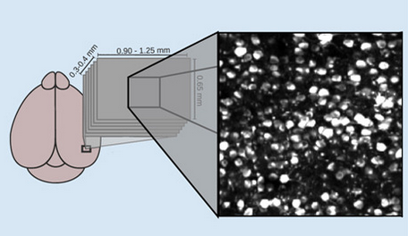
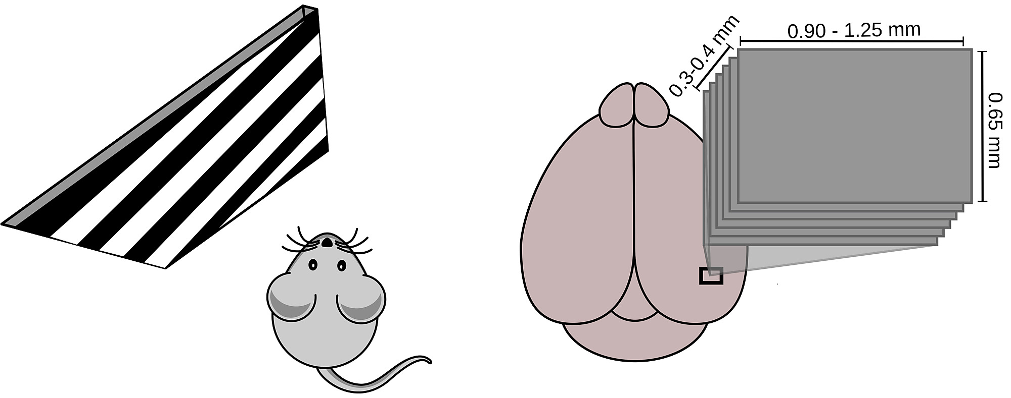

Introduction
Stringer et al. 2021 has reported a slight effect of locomotion on V1 cortex activity. Here, we explore this possibility, using linear and non-linear models.
Research question: Does locomotion change visual encoding in V1 cortex?
Dataset: Stringer orientations

Slide 3
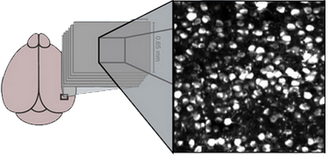

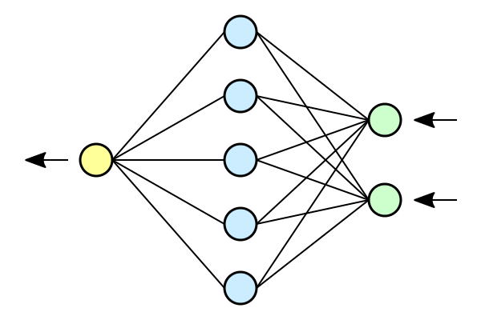
Methodology
Random sample ~1.000 neurons
~4500 trials
Locomotion trials (~46 %)
We predicted the stimuli angle for both groups
(70% train, 10% valid, 20% test)
Stationary trials (~54 %)
(70% train, 10% valid, 20% test)
Models: Linear Regression, Deep Regression, Deep Classifier, and 3D Convolutional Neural Network

Slide 4
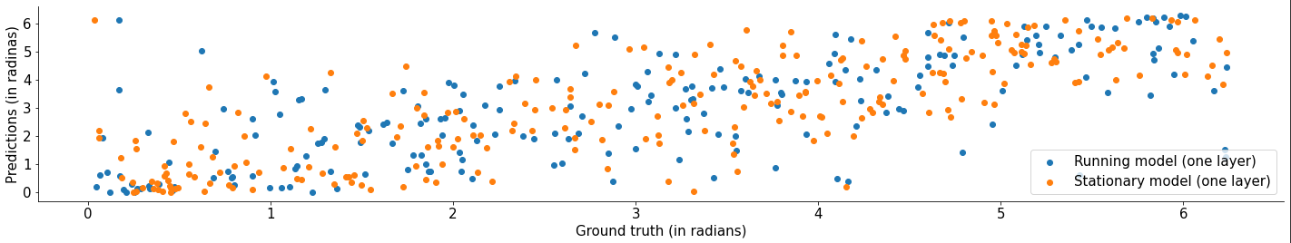

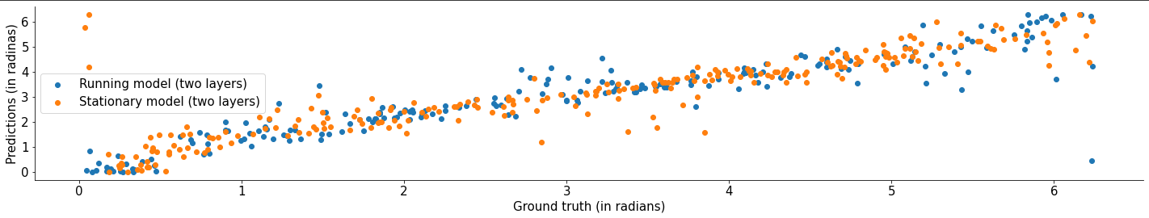
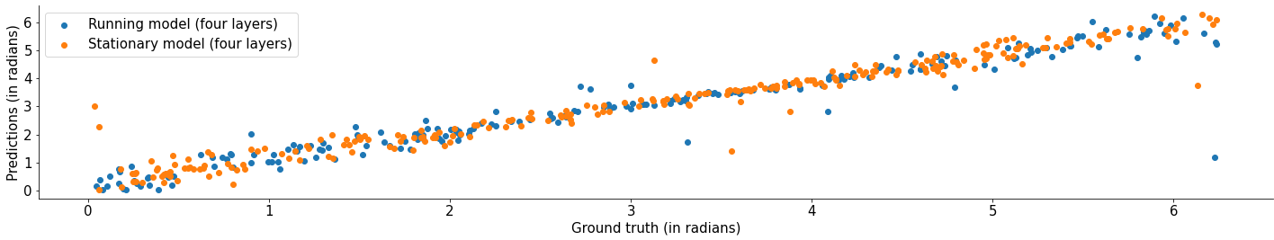
Deep Neural Network for Regression
(Validation data)

Slide 5
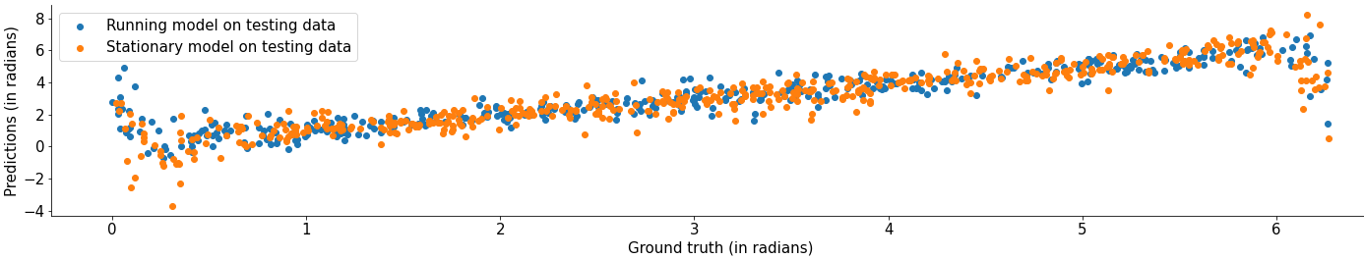
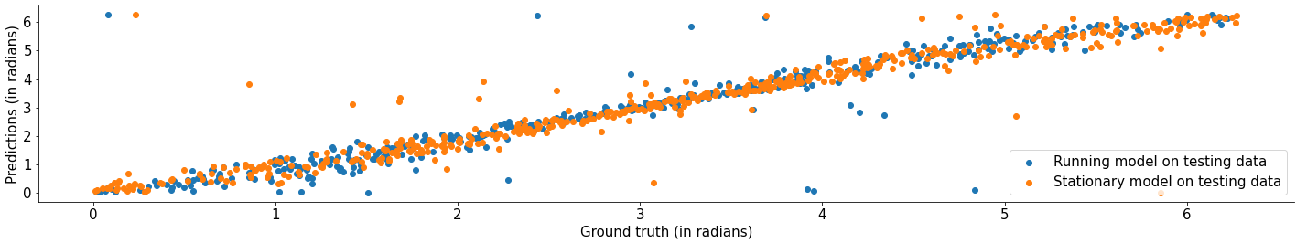
Models on testing data
Linear regression (baseline model) (using the whole 20k neurons for training)
rMSE for stationary model on stationary testing data: 0.7828087856124143 radians
rMSE for running model on running testing data: 0.7636812052813041 radians
Multilayer Perceptron (non linear)
rMSE for stationary model on stationary testing data: 0.5432999711091125 radians
rMSE for running model on running testing data: 0.6268552979008946 radians

Slide 6
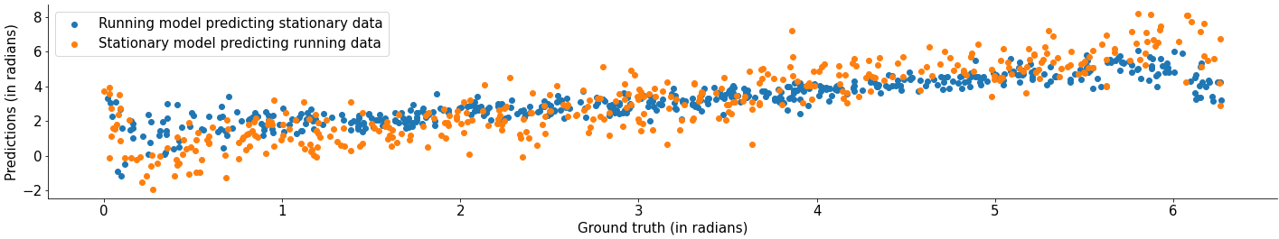
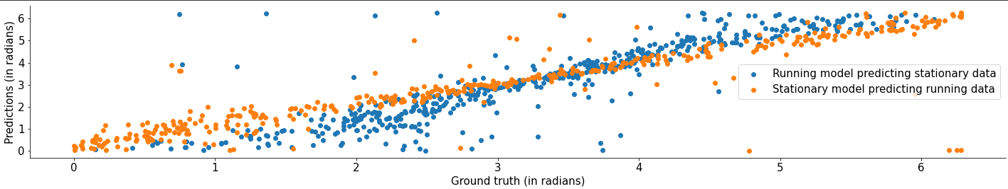
Testing running on stationary and vice versa
Linear Regression
Multilayer perceptron
The predictions’ error rate increased by ~20%!
This suggests the data follow different distributions for each group
We trained a neural network to predict if the mouse was moving or not based on the neural activity of the V1 cortex
It achieved ~90% accuracy in testing

Slide 7
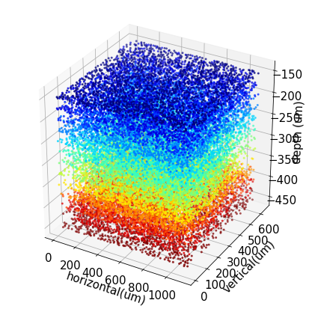
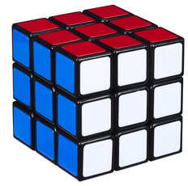
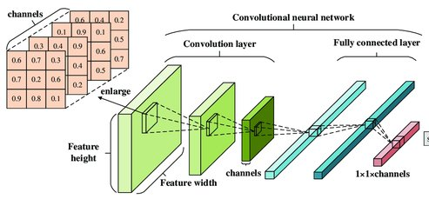
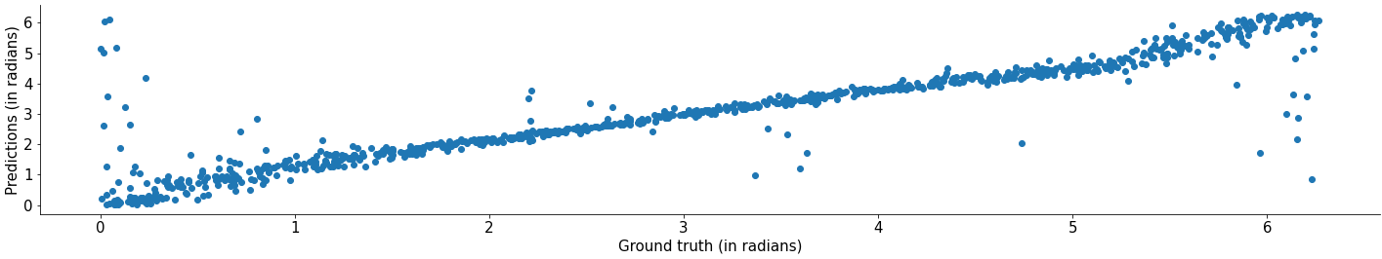
3D Convolutional Neural Network
~20.000 neurons
~4500 trials
(70% train, 10% valid, 20% test)
75 x 45 x 20
rMSE on testing data: 0.6813762885484544 radians

Slide 8
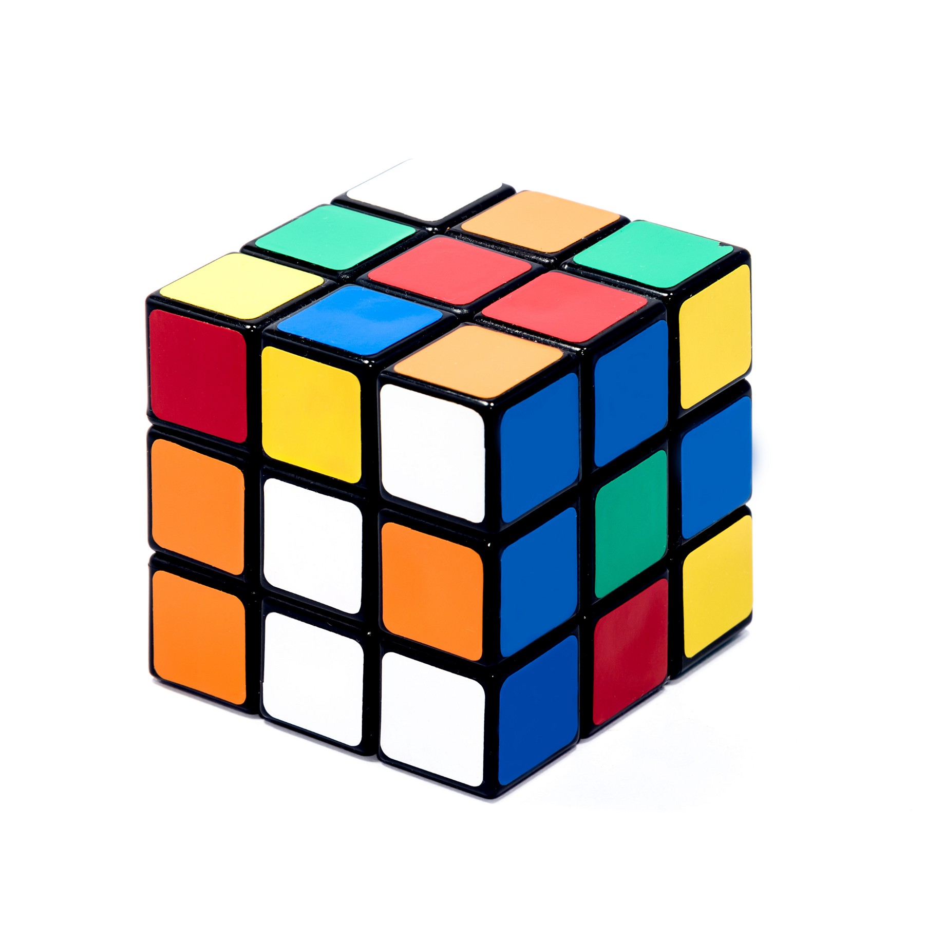
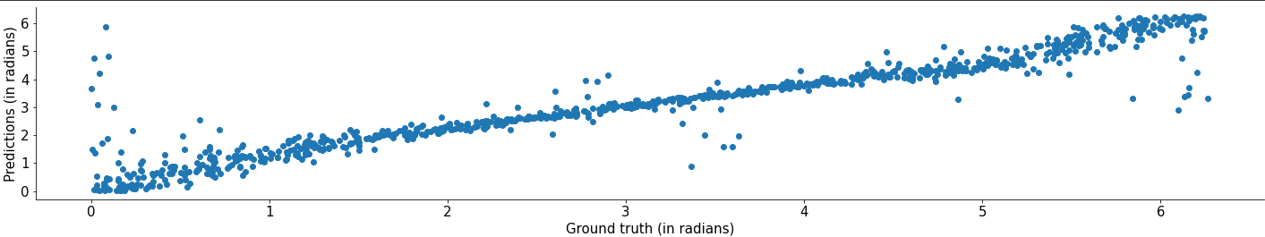
Shuffling the spatial data
75 x 45 x 20
75 x 45 x 20
rMSE on testing data: 0.59331568418689 radians

Slide 9
Conclusions
Neural activity in the V1 cortex does seem to follow different patterns depending on the movement of the mouse
Spatial information didn’t improve the precision of the decoder, suggesting it’s not relevant for the task

